Slide 1

MRI T2* Made Easy: What the Radiologist Needs to Know.
John C. Wood, MD, PhD
Children’s Hospital of Los Angeles
jwood@chla.usc.edu

Slide 2
Disclosures
Consultancy: Biomed-Informatics, AMAG ApoPharma,World Care, Celgene, Vifor, Pfizer
Research Funding: National Institutes of Health
Speaker’s Bureau: None
Employment: None
Equity: None

Slide 3
Why does the radiologist need to know iron physiology ?
Why should I use MRI at all ? I have serum ferritin.
How can my patient have high heart iron when his liver iron is low ? Or vice versa ?
If his heart (or pancreas, or liver) is full of iron, how come he has normal function ?
When should my patient get his first scan? When should he get the next scan ?
Is it ok to just look at the abdomen or do I need to look at the heart, too ?

Slide 4
Why care about iron overload ?
Iron overload is surprisingly common
Hereditary hemochromatosis
Porphyrias
Liver disease
Hemoglobinopathies
Thalassemia
Sickle Cell Disease
Myelodysplastic syndromes
Iatrogenic marrow suppression (chemotherapy)

Slide 5
Iron toxicity
Direct
Endocrine dysfunction
Pituitary
Pancreas
Thyroid and parathyroid
Hepatic fibrosis
Cardiac dysfunction
Indirect
Atherosclerosis
Endothelial dysfunction
Osteoporosis
Inflammatory syndromes
Malignancy

Slide 6
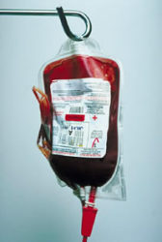
How Fast Does Iron Overload Occur ?
Normal liver iron is 1 mg/g, dry wt.
A transfusion of 15 cc/kg PRBC raises liver iron 1 mg/g.
The body can only eliminate one transfusion per year.
Chronic transfusion therapy of 15 cc/kg every 3 weeks will cause liver iron to increase to around 18 mg/g in 1 year.

Slide 7
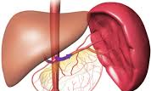
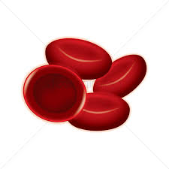

Two forms of iron
LPI
Transferrin
Liver
Pump
The liver and spleen iron represent the balance between the total transfused iron and iron losses (chelation).
The endocrine glands (pancreatic, pituitary) and heart iron reflect chronic exposure to labile plasma iron (LPI).
If bone marrow utilization is low (Blackfan Diamond, β₀ thalassemia), the heart can fill even if liver iron is low.

Slide 8
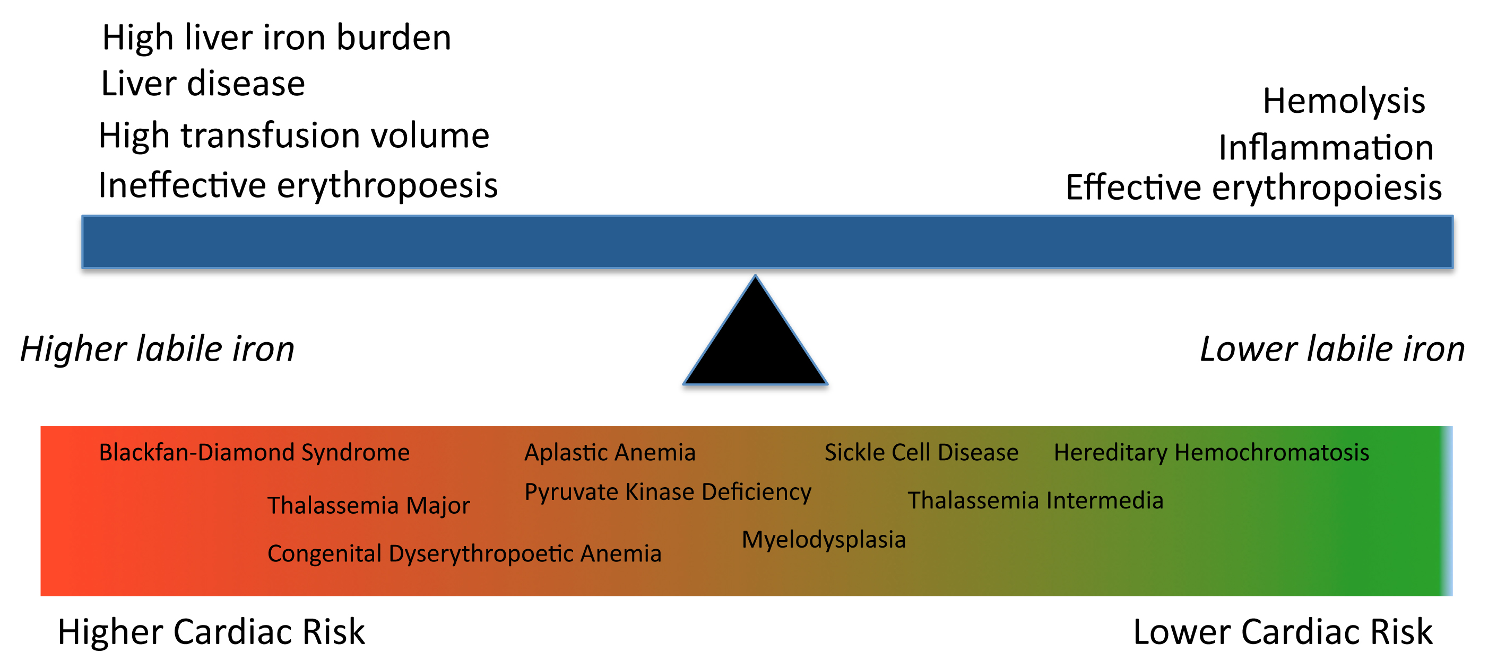
Cardiac iron risk

Slide 9
Chelation
Sun
Mon
Tues
Wed
Thurs
Fri
Sat
Heart,
endocrine
Doses
Heart,
endocrine
LPI
transfusions
LIC≈
Doses
chelation
LPI
The liver cares about how many grams per week of iron chelators.
The heart (and endocrine glands) cares about how many days per week there is iron chelation.

Slide 10
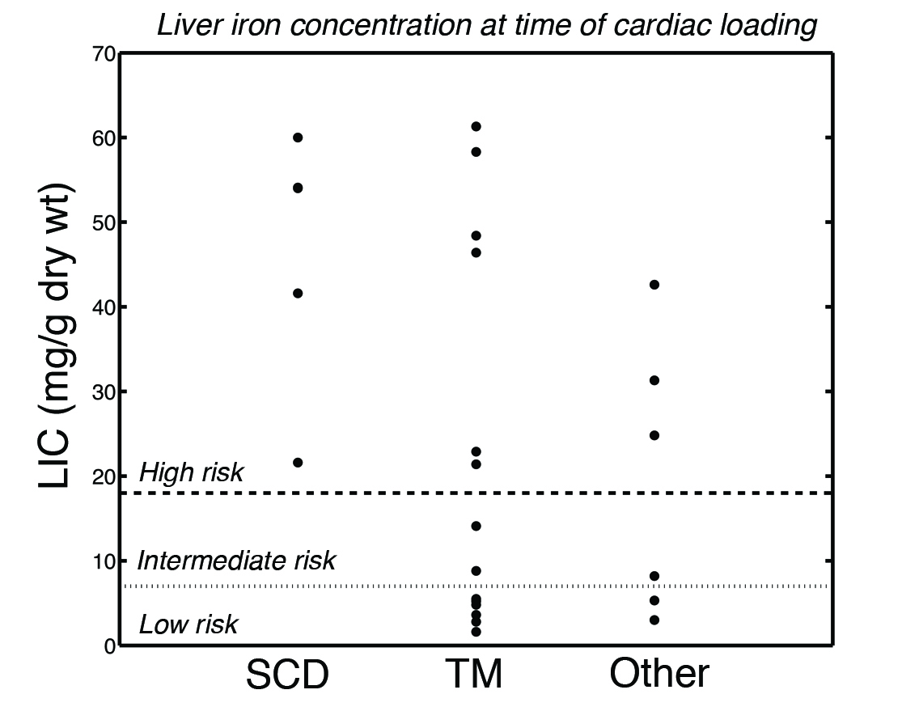
LIC level at de-novo cardiac iron
We observed 23 patients go from a “clean” heart to a “dirty” heart.
LIC levels at the time of cardiac loading range from 2.0 – 64 mg/g.
x
x
Heart Iron
x
x
x
x
x
x
Time

Slide 11
How can the radiologist help ?
Provide accurate and accessible estimates of liver iron and cardiac T2*.
Look for evidence of pancreatic iron loading.
R2* can be estimated just like for liver
Signal-intensity ratios
Qualitative scale (none, mild, moderate, severe)
Doses
LPI
Pancreas R2*

Slide 12
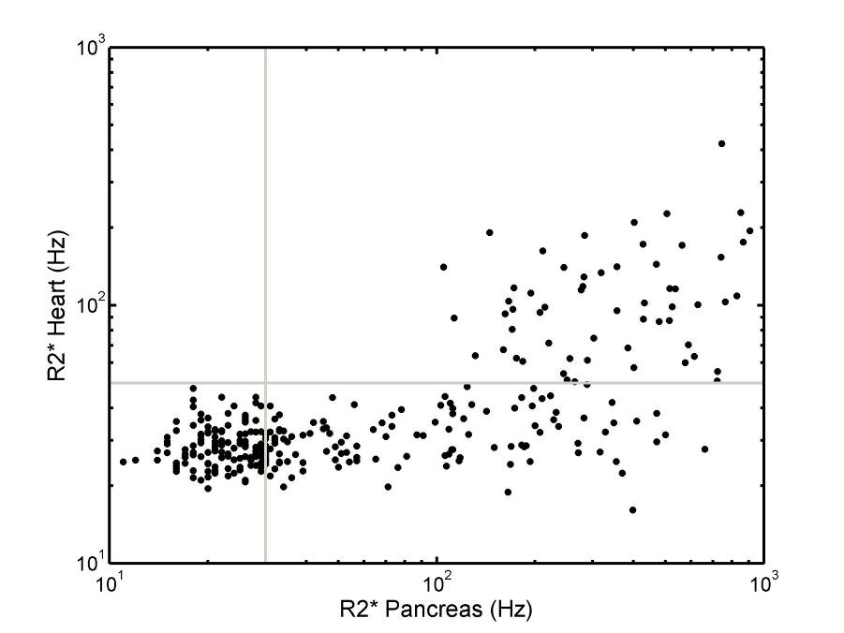
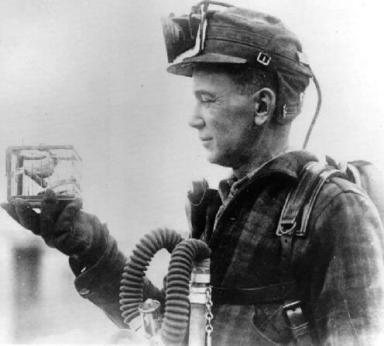
Pancreatic iron heralds heart iron !
- Pancreas
+ Heart
+ Pancreas
+ Heart
R2* = 100 Hz
CHLA
Pancreas loads earlier than the heart.
If you see pancreatic R2* > 100 Hz, look at the heart !
Noetzli et al, Blood 2009
Noetzli et al, BJH 2011
http://www.artsjournal.com/dewey21c/canary_0.jpg

Slide 13
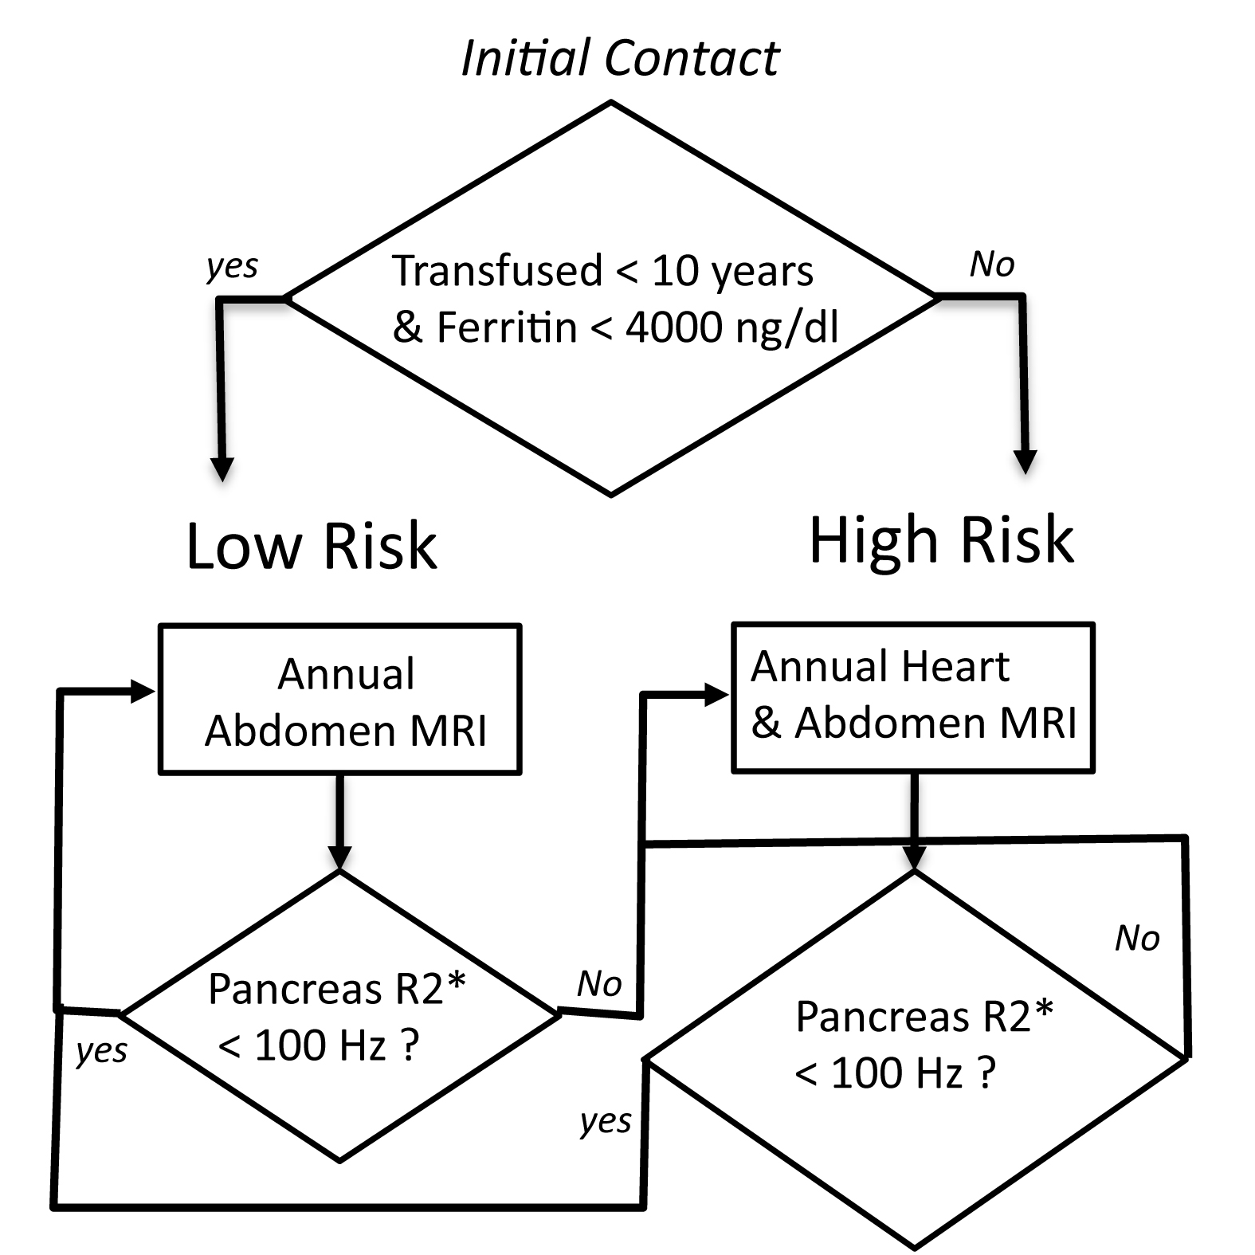
Staged MRI screening
Pancreas R2* < 100 Hz
Wood J, Blood Cell Mol Dis, 67:120-5,2017

Slide 14
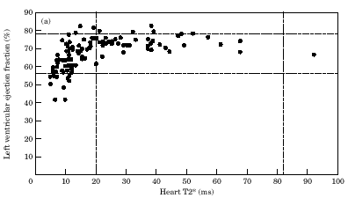
Cardiac T2* and cardiac dysfunction
Relative risk of cardiac symptoms increased
with estimated cardiac iron load.
No patient without evidence of iron was ill.
Many patients with heavy iron overload asymptomatic.
Left ventricular ejection fraction (%)
No correlation between heart and liver iron.
Heart T2* (ms)
Anderson et al., Eur Heart J, 2001 22(23) 2171-2179

Slide 15
What is cardiac T2* measuring ?
Lysosome
Labile iron
Weak T2*
Strong T2*
No T2*
Ferritin
Cardiac Muscle Cell
T2* measures the “potential” for labile, toxic, iron
Both the intensity and duration of iron loading are important

Slide 16
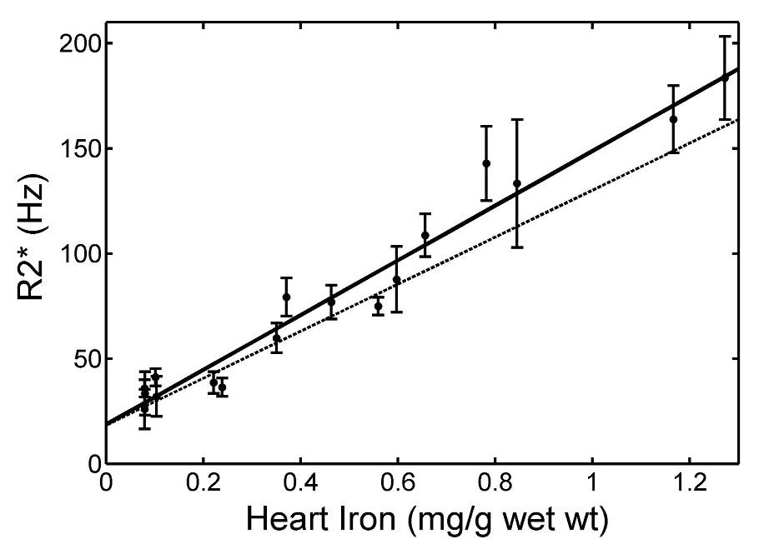
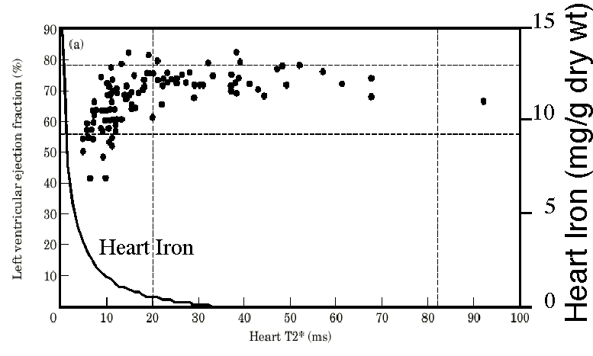

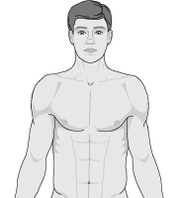
Heart R2* predicts Heart Iron in the Gerbil
x
Autopsy
Heart Iron
x
T2* in high risk patients
Wood et al, Circulation, 2005

Slide 17
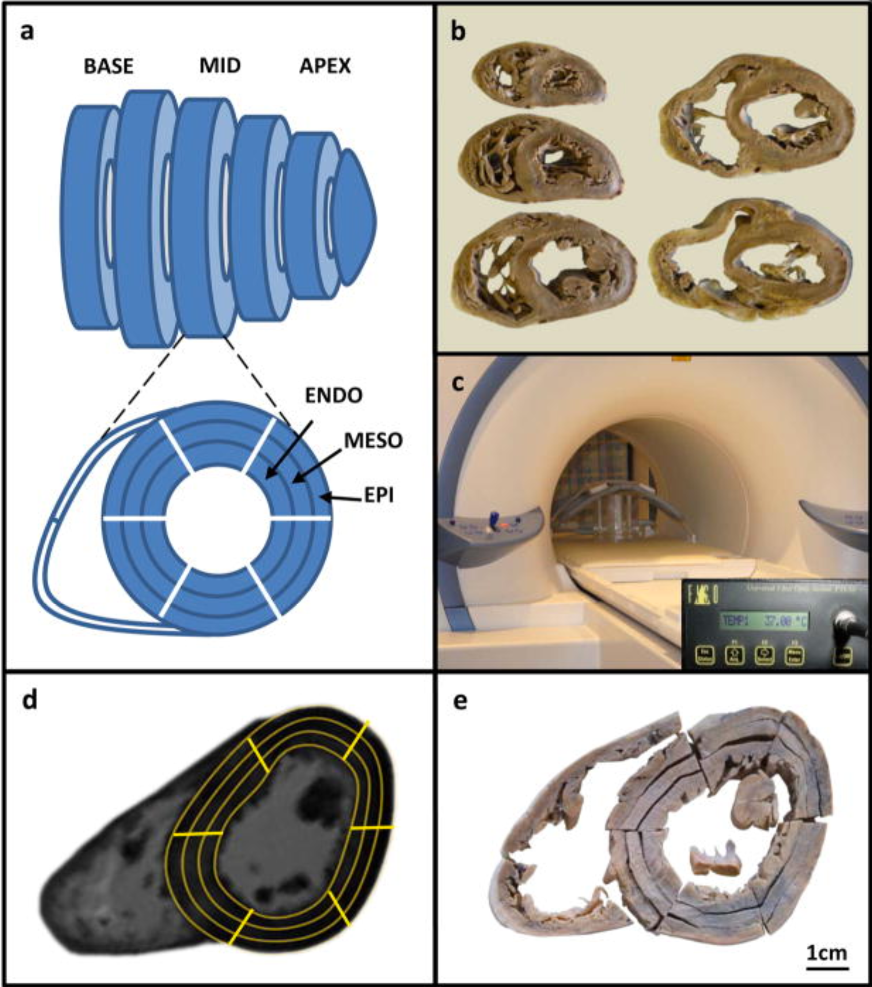
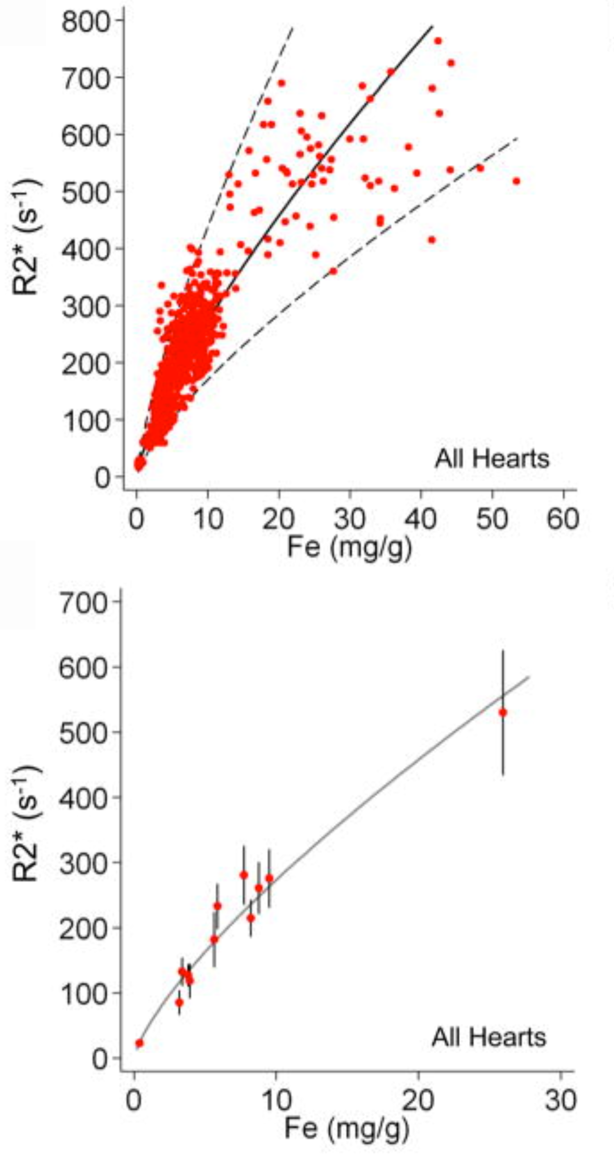
Autopsy Validation (12 hearts)
Ghugre et al, 2006
Carpenter et al, Circulation 123(14), 1519:28, 2011

Slide 18
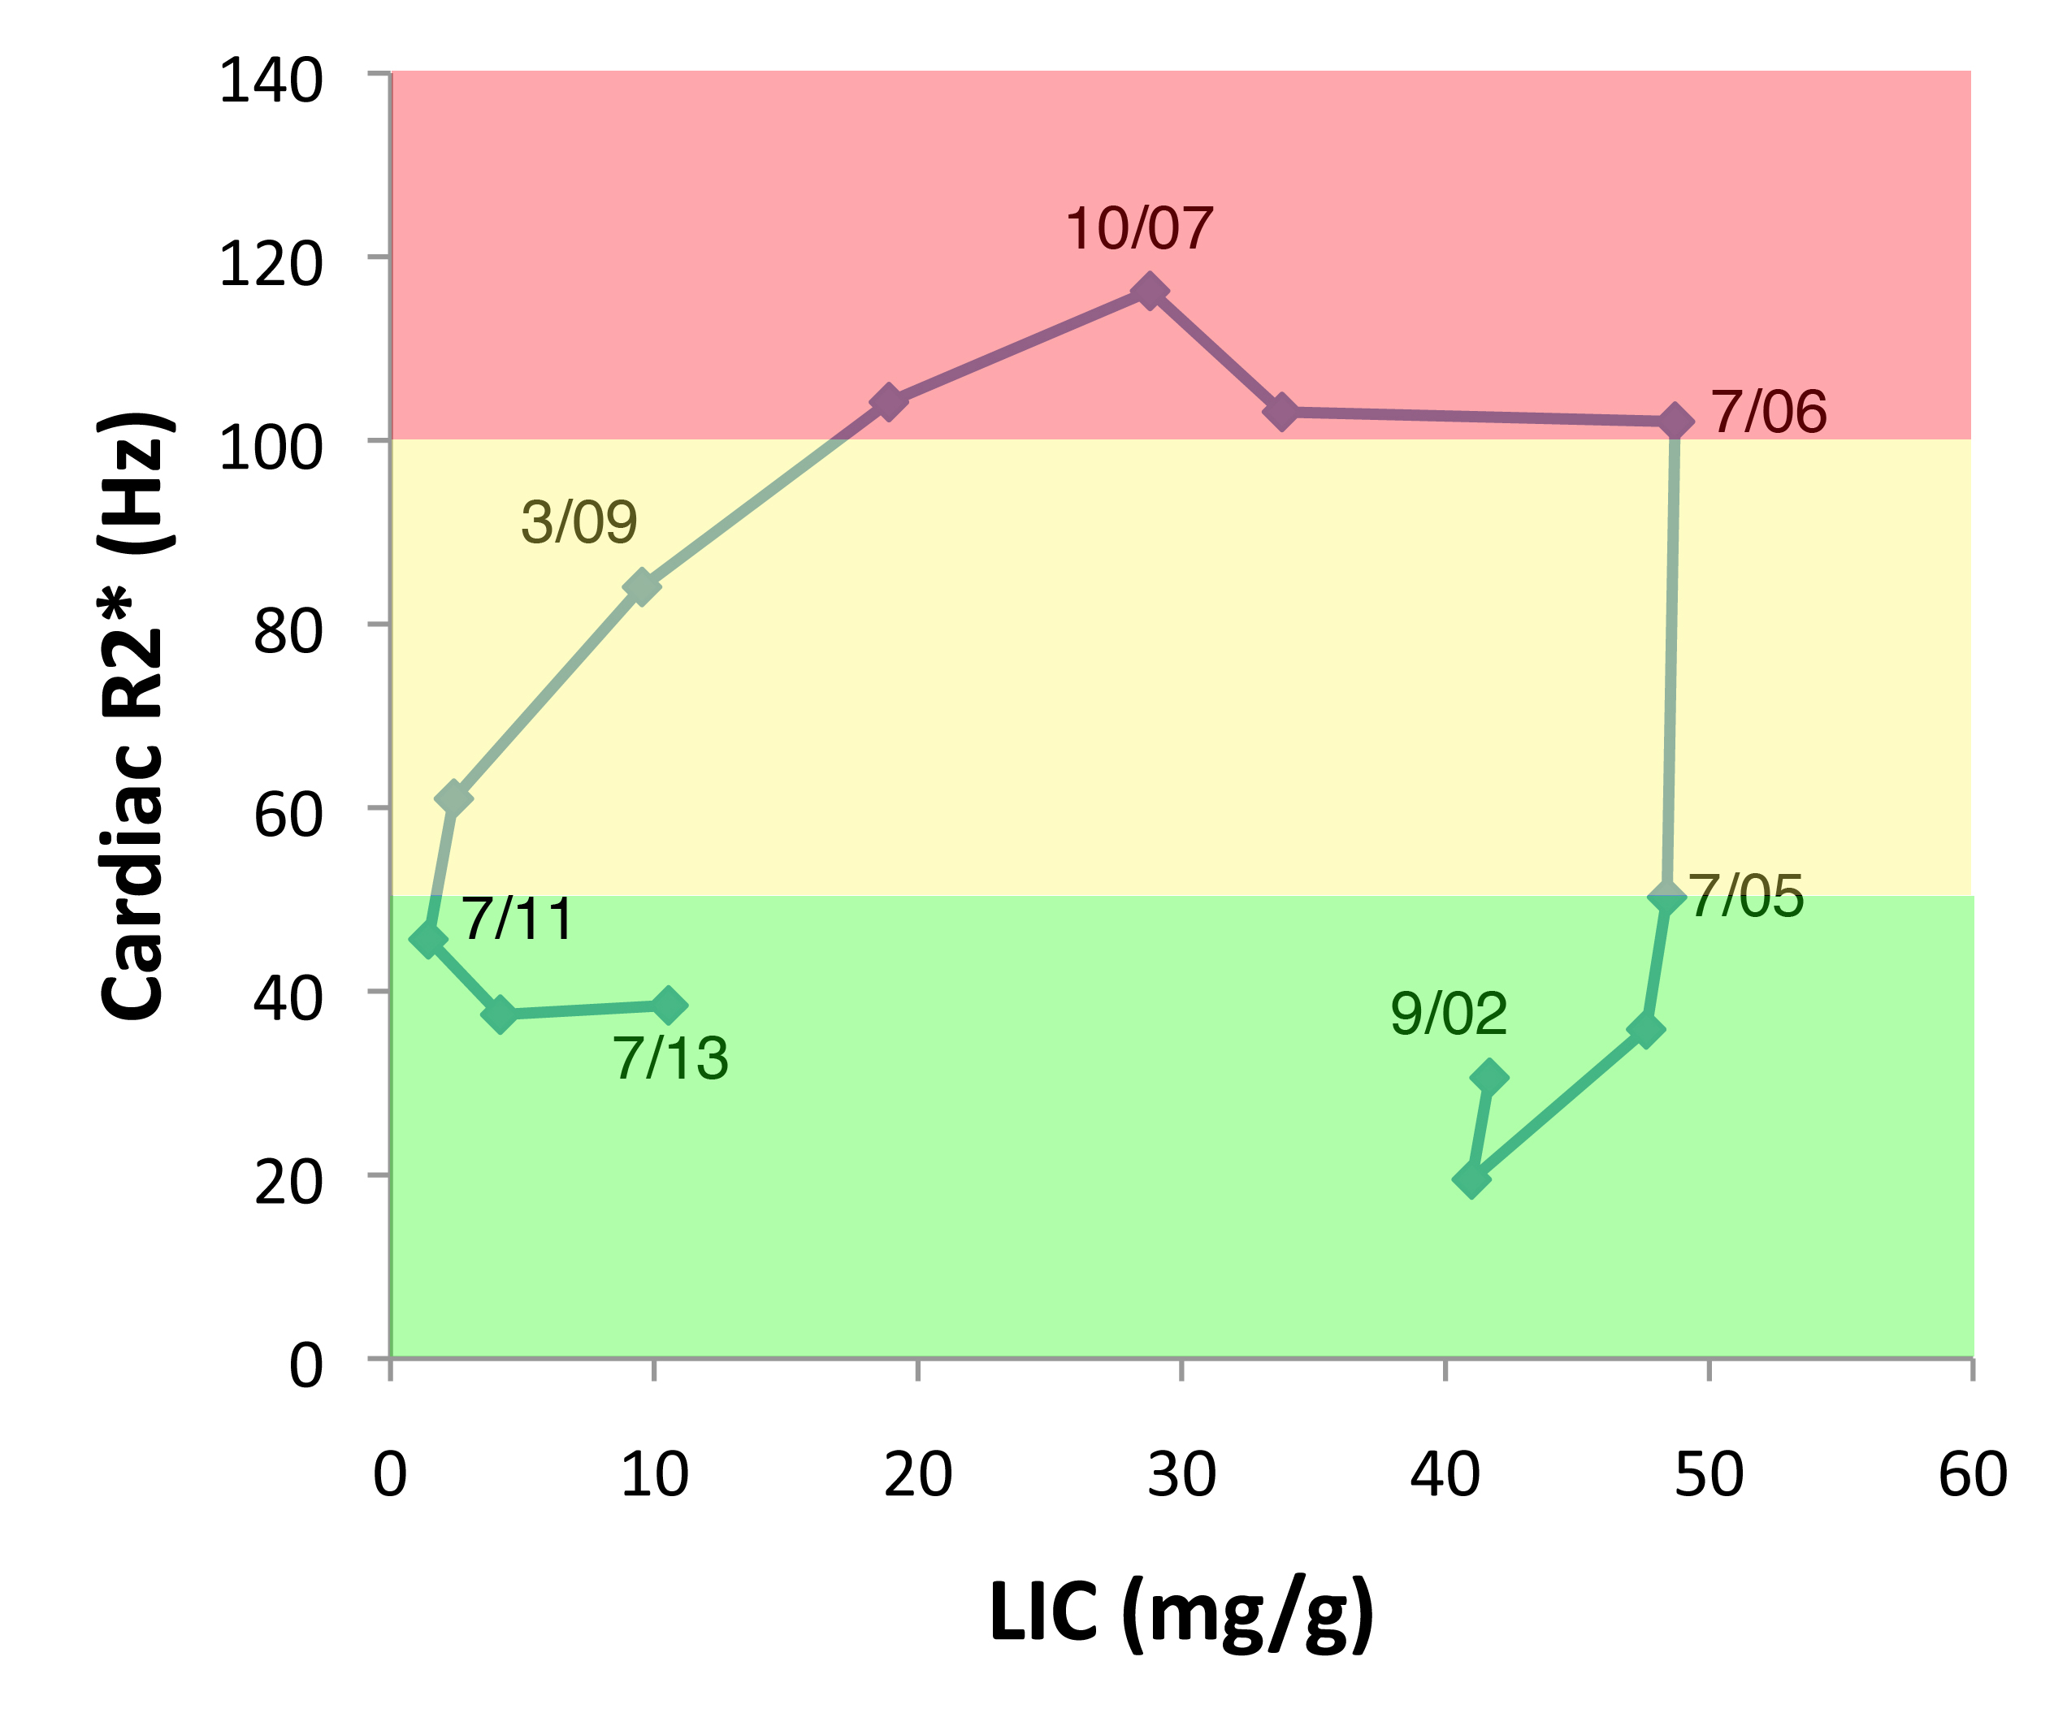

Fast Uptake/Slow Clearance
Liver Iron

Slide 19
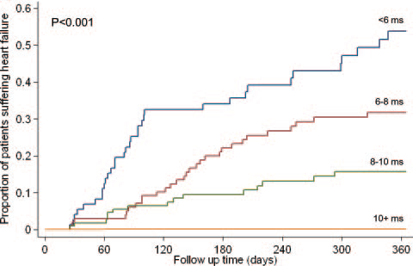
Cardiac T2* and cardiac dysfunction
Left ventricular ejection fraction (%)
Kirk et al, Circulation, 120(20)1961-8, 2009

Slide 20
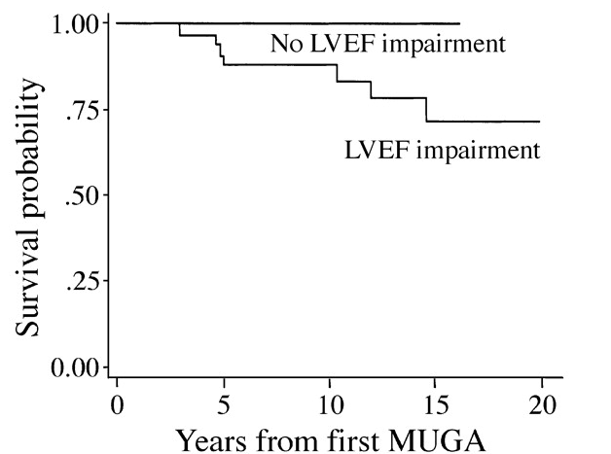

Previous Paradigm to Protect the Heart
Adjust chelation to control total body iron load, estimated by ferritin or liver iron.
Monitor for cardiac toxicity (function, ECG changes, arrhythmias).
From taxistartup.com
Davis B A et al. Blood 2004;104:263-269

Slide 21
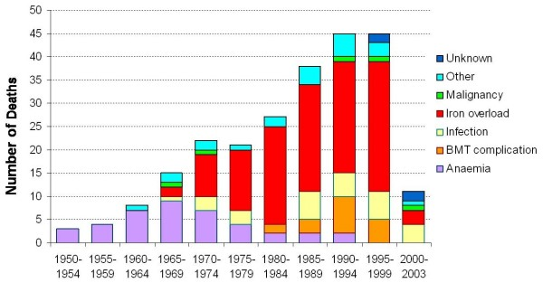
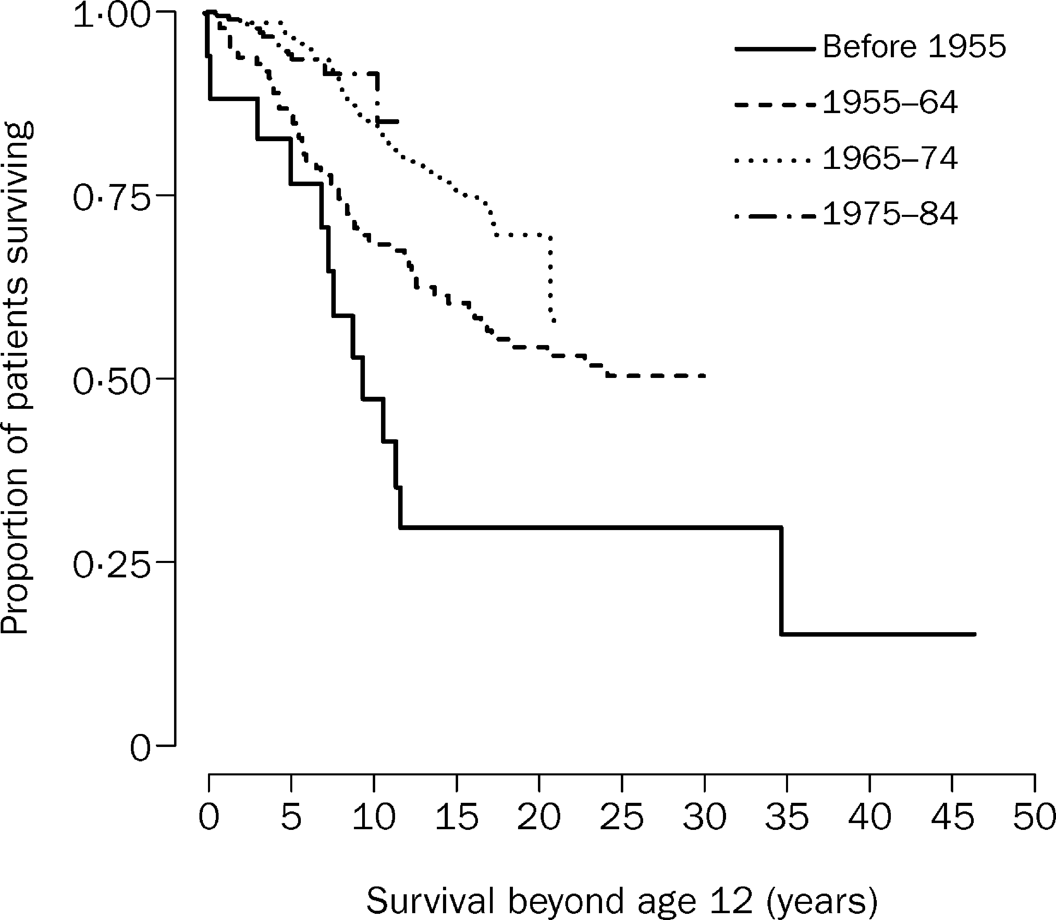
Trends in Mortality
Modell et al, JCMR, 10(1):42, 2008

Slide 22
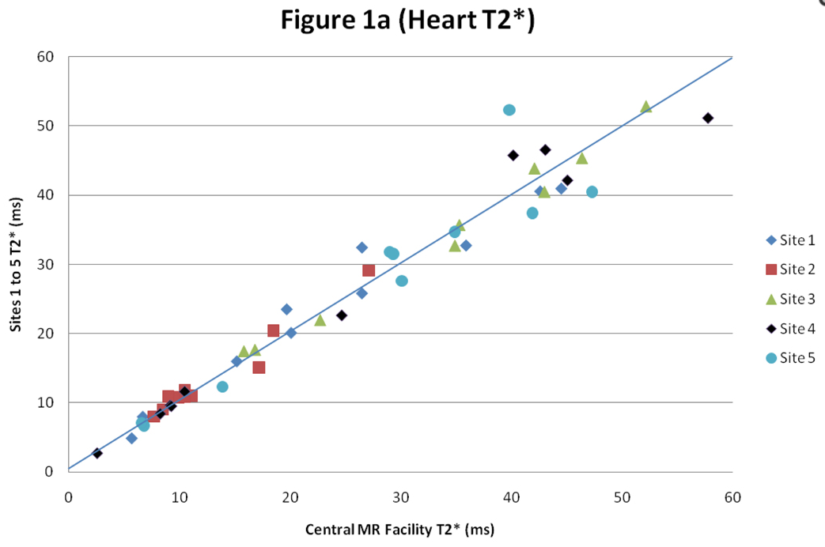
Transition to standard of care
Interexam/Interreader Reliability
Anderson et al, Eur Heart J, 22(23)2171-9, 2001
Westwood et al, Int J Card Im 21(5):531-8, 2005
Kirk et al, JMRI 32(2):315-319, 2010
Picker to Siemens
Westwood et al, JMRI 18(5):616-20, 2003
Multi BH to single BH
Westwood et al, JMRI 18(1):33-9, 2003
White Blood to Black Blood
Smith et al, JCMR 13(21):21, 2011
Single Center to Multicenter
Westwood et al, Int J Card Im 21(5):531-8, 2005
Kirk et al, JMRI 32(2):315-319, 2010
Single breathhold, COV 5.9%
49 patients
Kirk et al, JMRI 32(2):315-319, 2010

Slide 23
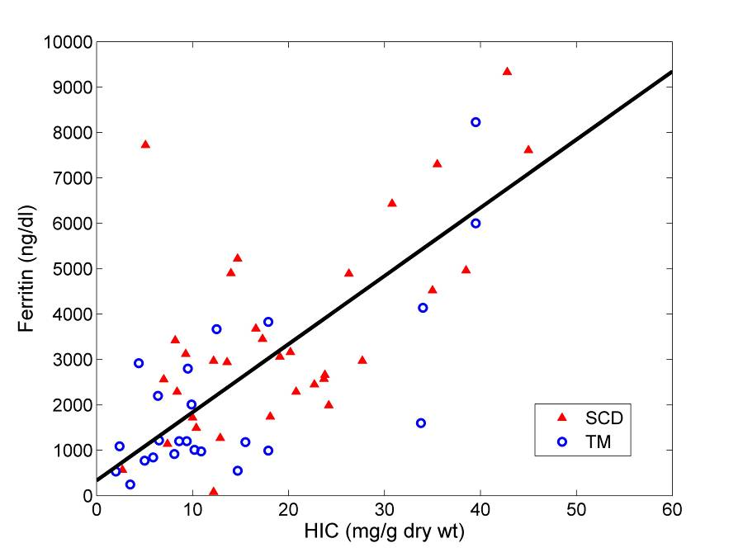
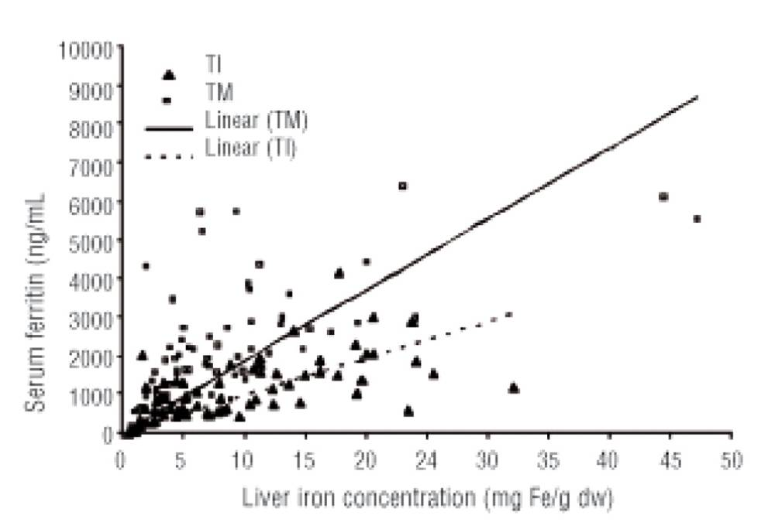
How good is serum ferritin ?
Serum Ferritin (ng/dl)
Liver Iron Concentration (mg/g)
Wood, et al, unpublished data
Taher, et al, Haematologica, 93(10):1584, 2008

Slide 24
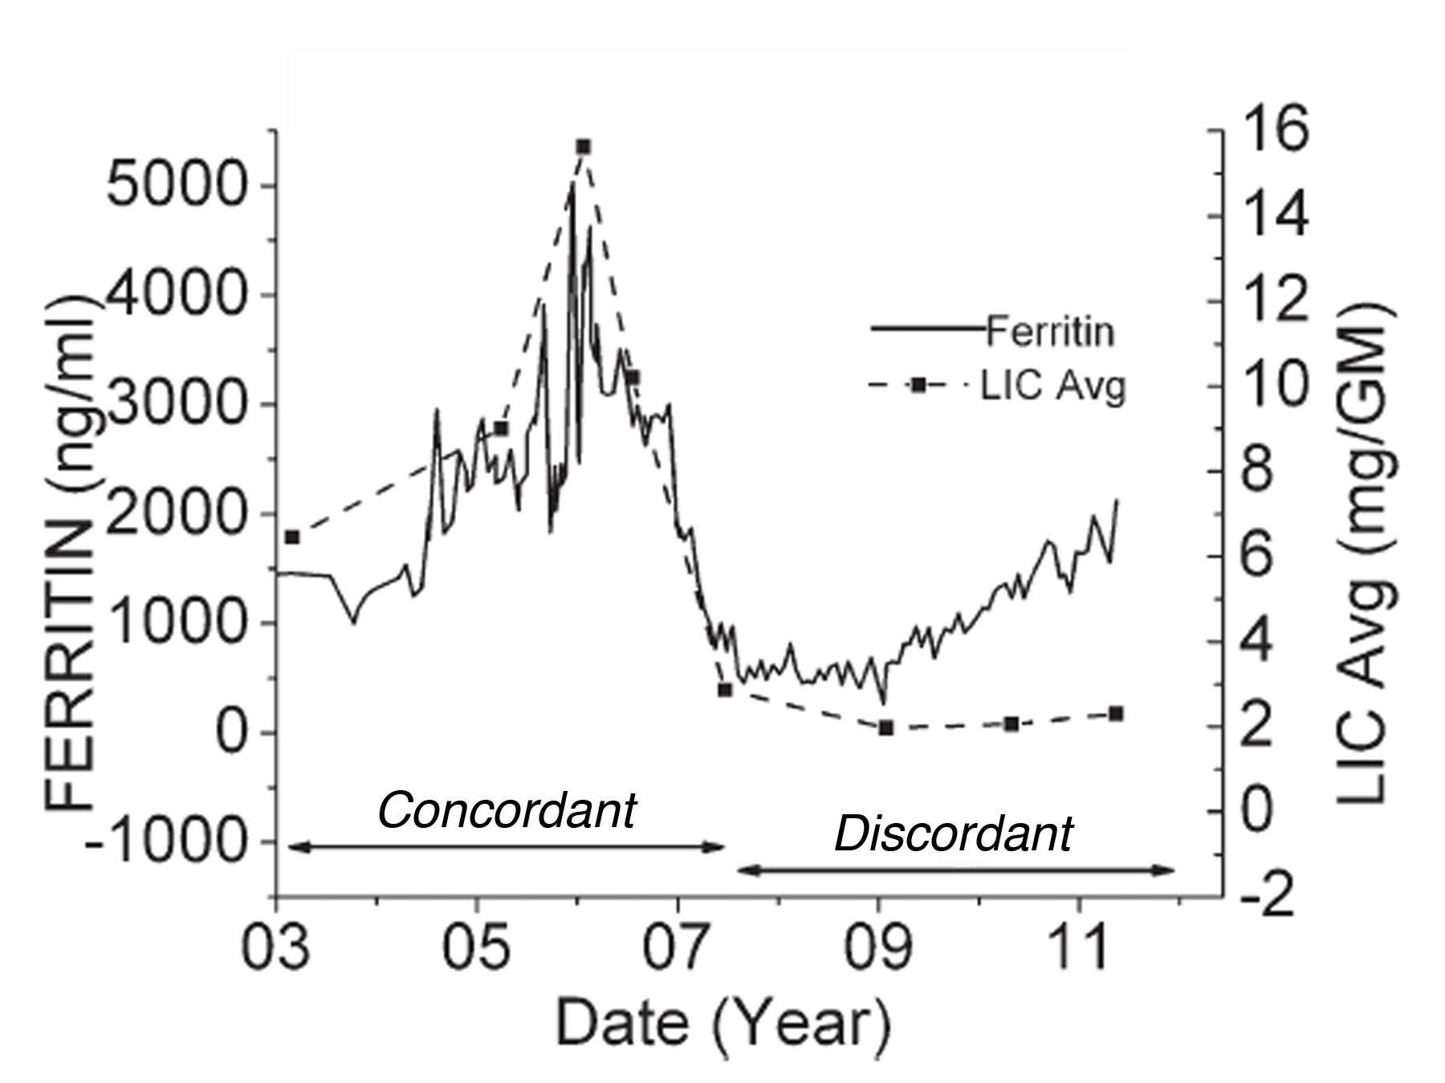
Serum Ferritin Tracks LIC…except when it doesn’t !
Using trends, overall r² was 0.64.
Trends in serum ferritin concordant with LIC in only 38% and overtly discordant in 28%.
Correlated poorly with LIC in transfused SCD patients.
Highly variable in nontransfused patients.
Puliyel et al, Am J Hematol 89(4):391-394,2014

Slide 25
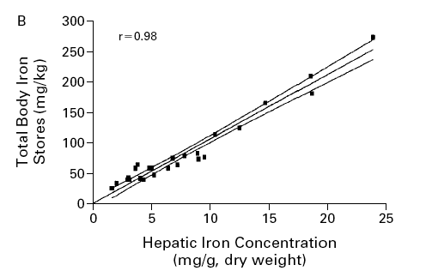
Liver Iron Reflects Iron Balance
Angelucci et al, NEJM, 343, 2000

Slide 26
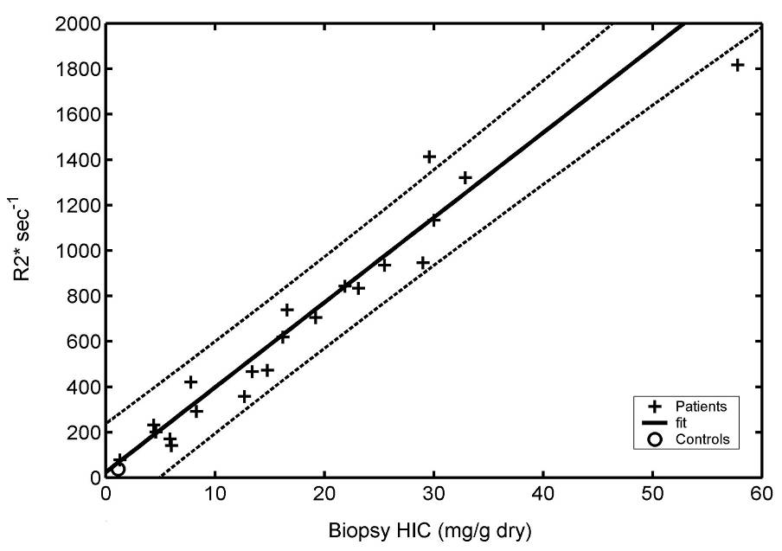
Liver R2, R2* and iron
r = 0.97
Wood et al., Blood, 106, 2005
St Pierre et al, Blood, 105(2) 855-861, 2004

Slide 27
R2 versus R2*, that is the question
Ferriscan R2
Liver R2*
Advantages
Good Quality Control
Well Validated
Disadvantages
Expensive
Less Robust to Tissue Iron Distribution and B1+ inhomogeneity
Longer Exam
Non-zero Failure Rate
Advantages
Fast
Robust and Temporally Stable
Disadvantages
Requires Analysis Software
Requires Local Expertise
Smaller Dynamic Range

Slide 28
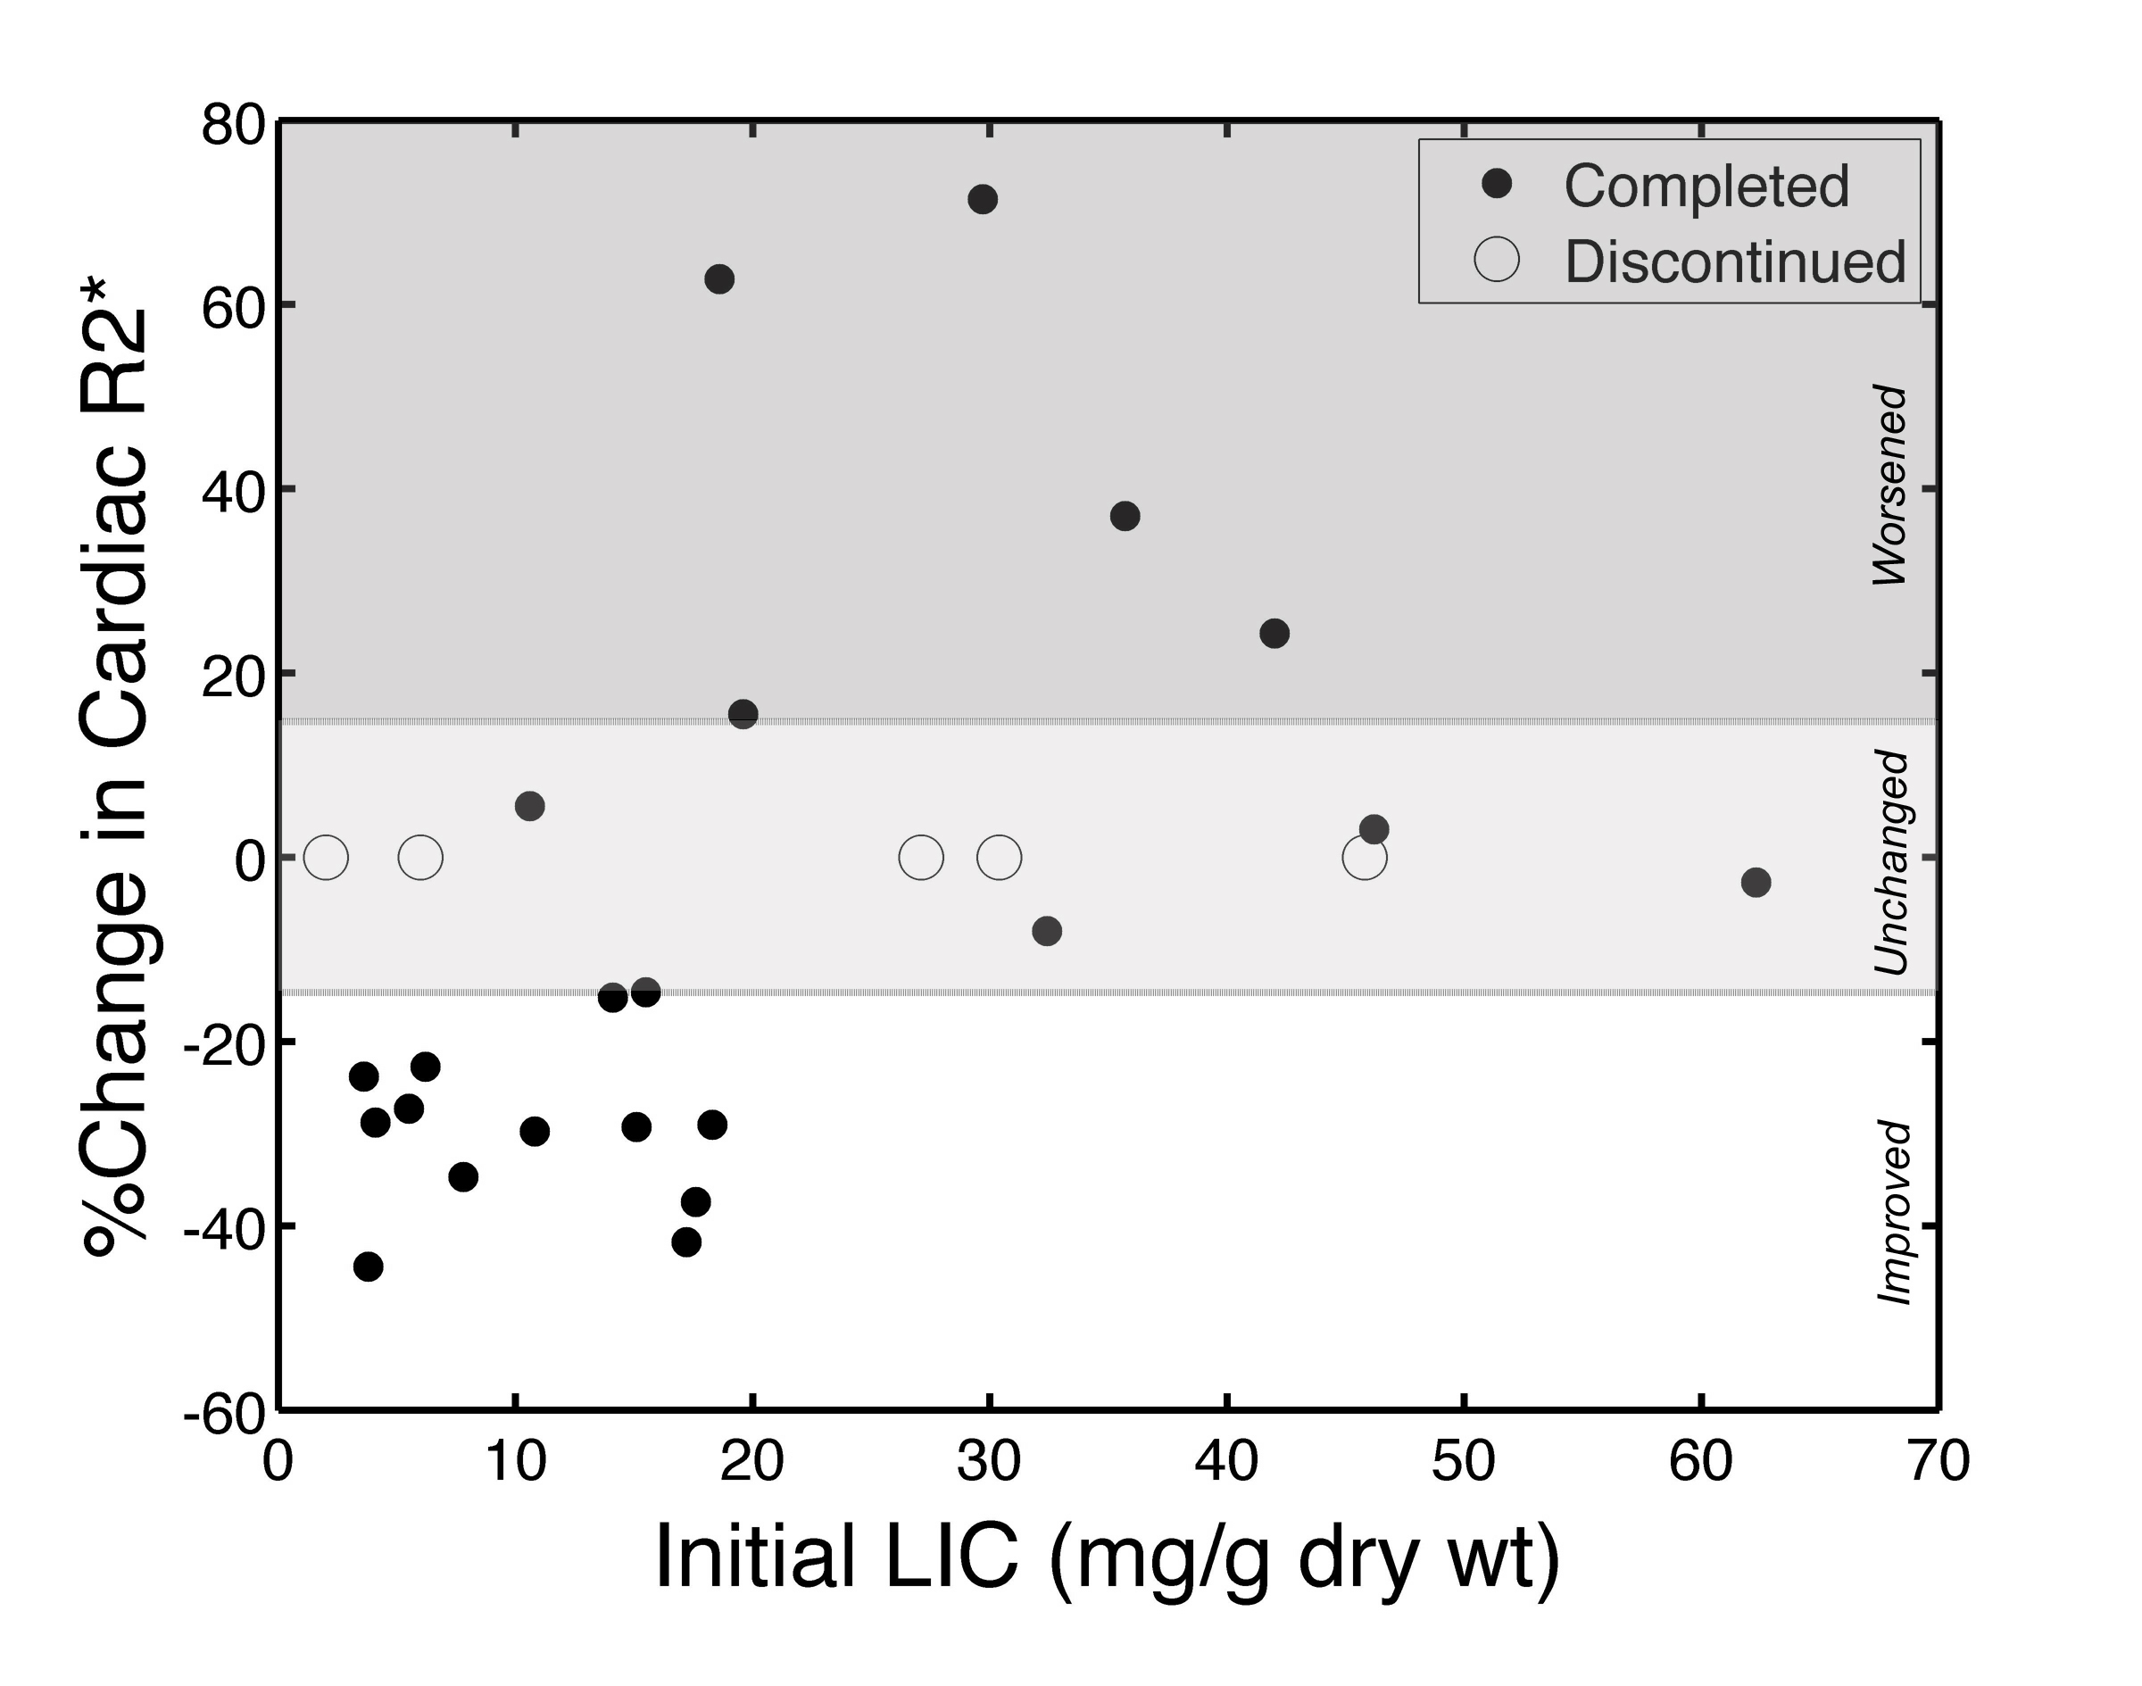
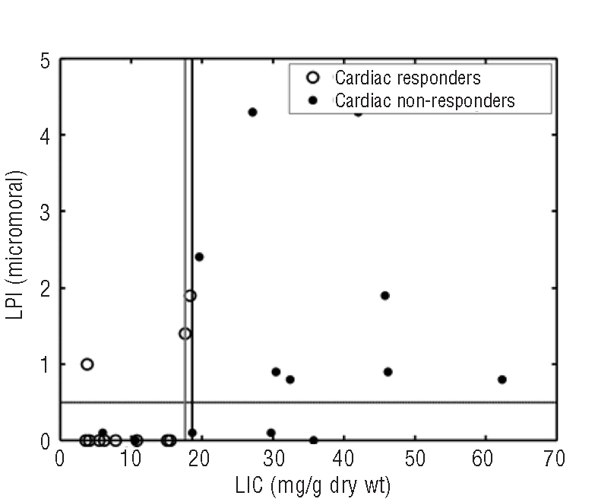
High liver iron is bad.
LIC predisposes to circulating LPI if chelator not present.
Penalty for noncompliance is much worse for LIC !

Slide 29
So what is a “safe” LIC
There is no “safe” LIC
LIC’s > 15-20 mg/g are often very unsafe
But the actual threshold varies with patient

Slide 30
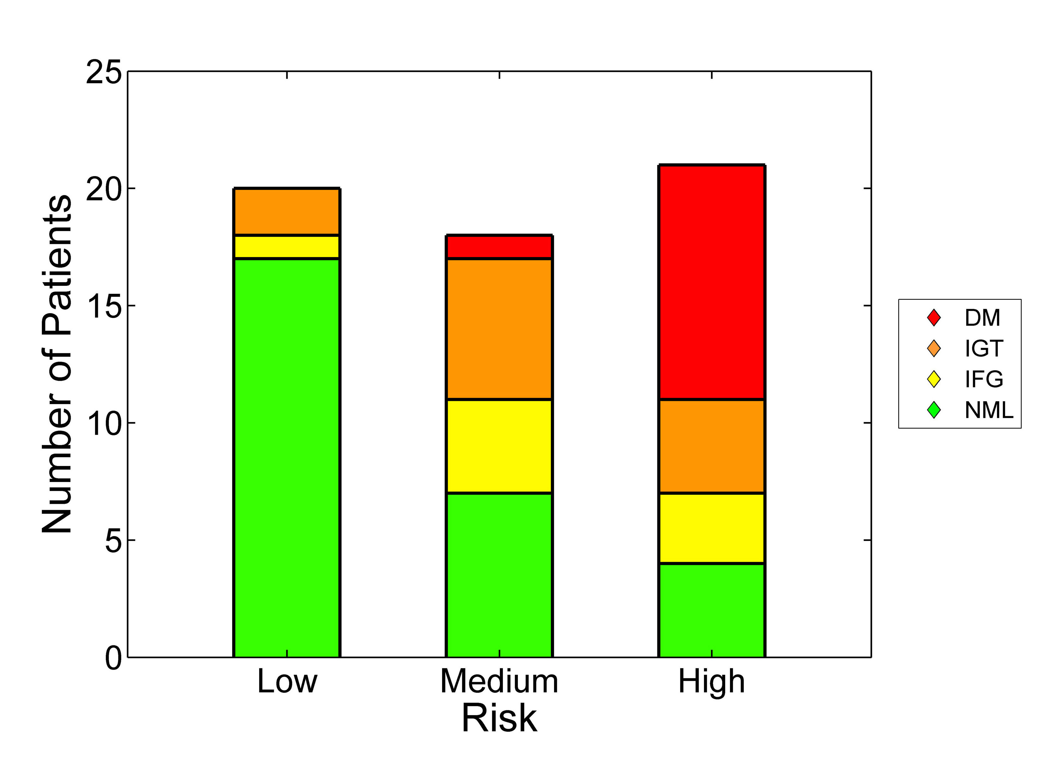
So can’t we wait until T2* falls
Heart loads quickly, clears slowly
The glands are beat up by the time T2* falls.
Pancreas
- Heart
+ Pancreas
- Heart
+ Pancreas
+ Heart

Slide 31
Model of disease
Iron
Volume
Dysfunction

Slide 32
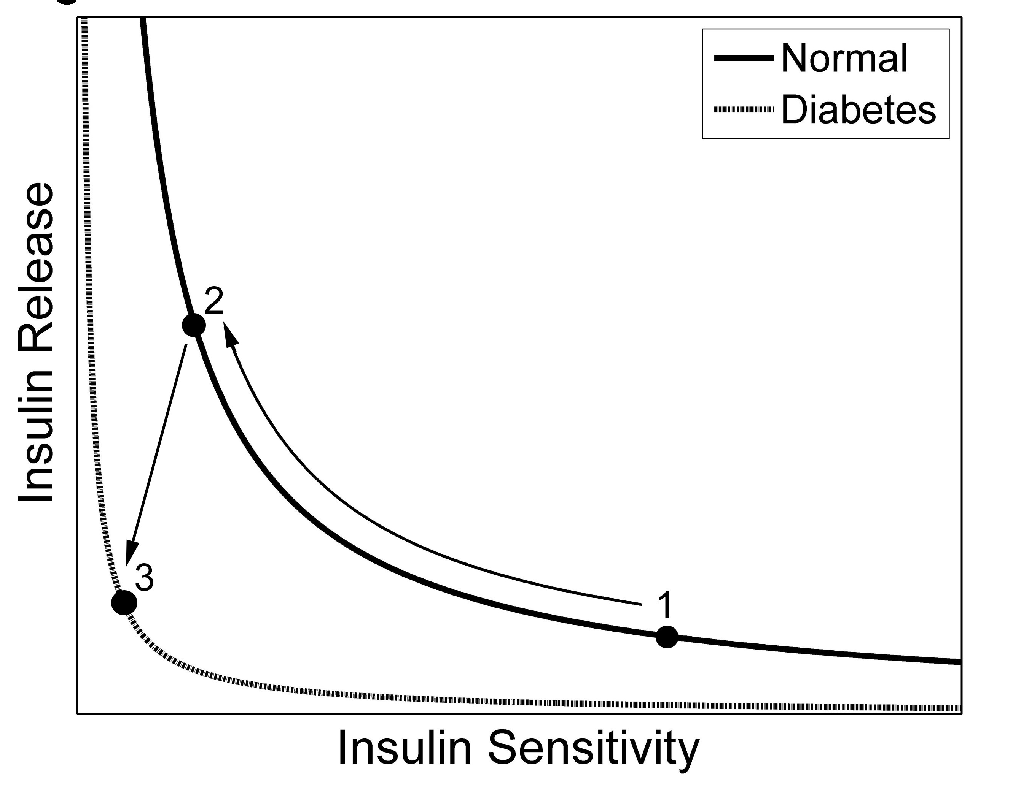
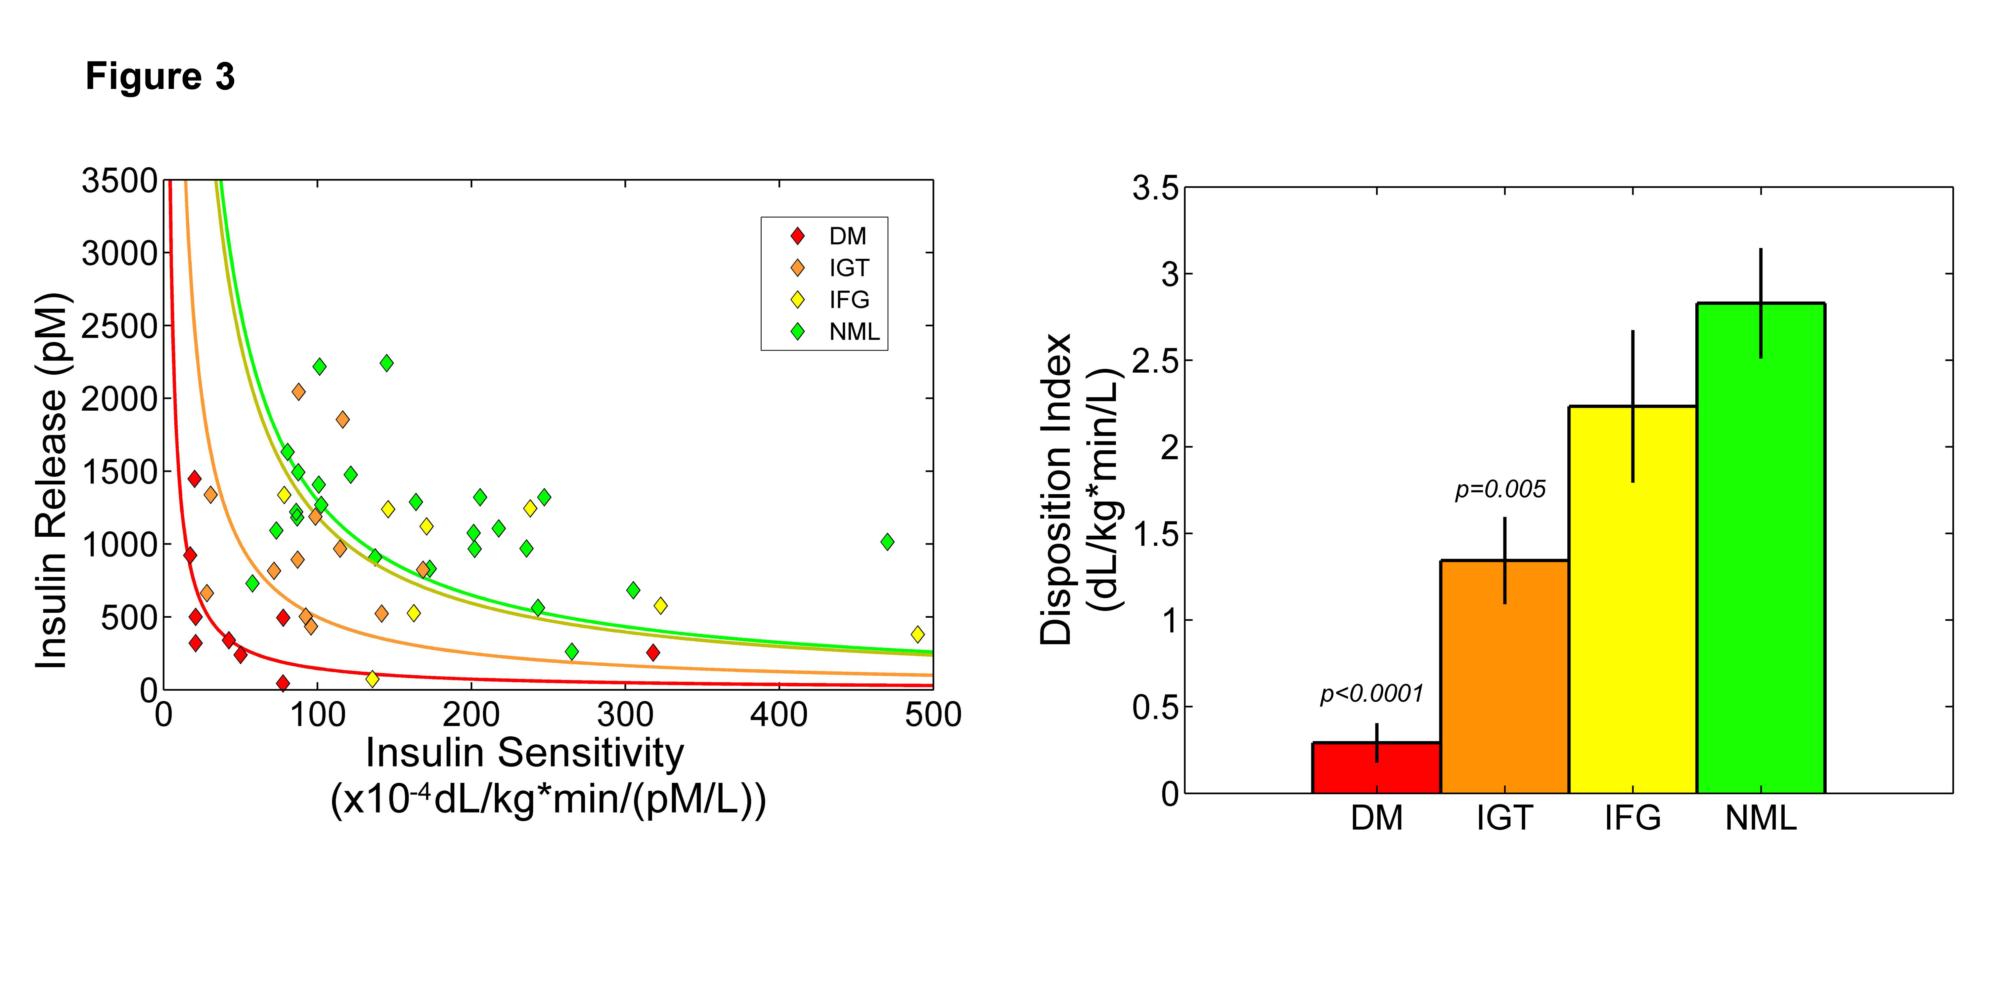
Pancreas R2* and glucose dysregulation
Disposition Index
DM: Diabetes Mellitus
IGT: Impaired Glucose Tolerance
IFG: Impaired Fasting Glucose
NML: Normal Glucose Tolerance
Noetzli et al, Am J Hematol, 87(2):155-60, 2012

Slide 33
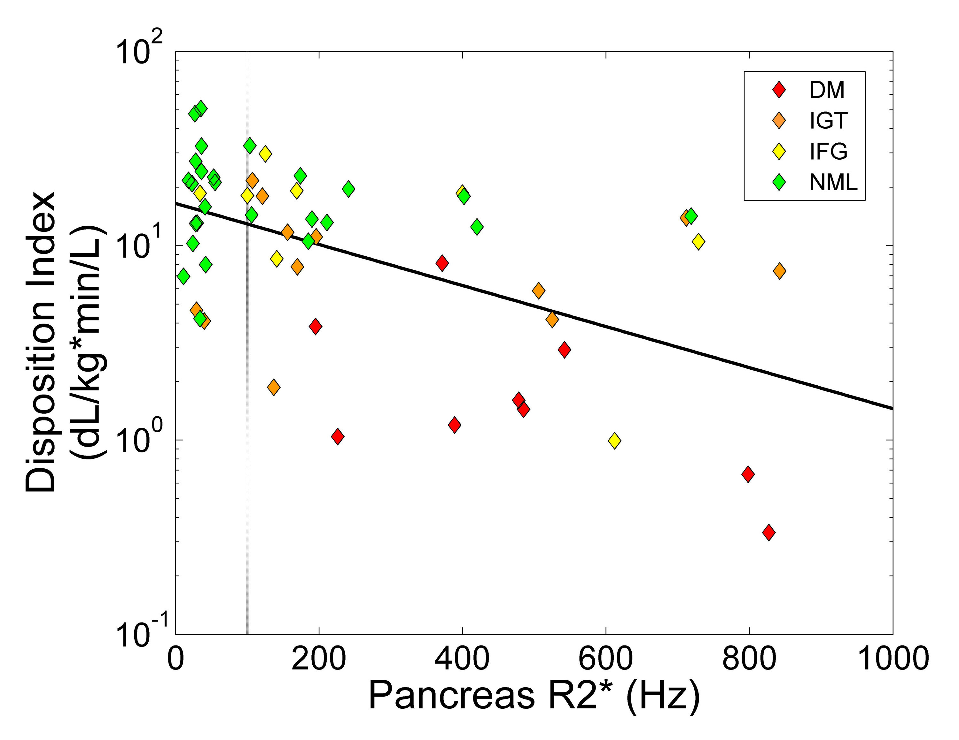
DI Correlates and Predictors
Age & LIC
DI values stratified by disease severity.
DI predicted by pancreas R2*, age, and LIC

Slide 34
Prevalence of Endocrine Dysfunction
Endocrinopathy | Borgna-Pignatti 2004 | Vogiatzi et al 2009
Hypogonadotropic Hypogonadism | 54.7 | 51.3
Hypothyroidism | 10.8 | 12
Diabetes Mellitus | 6.4 | 14.1
Hypoparathyroidism | -- | 2.1

Slide 35
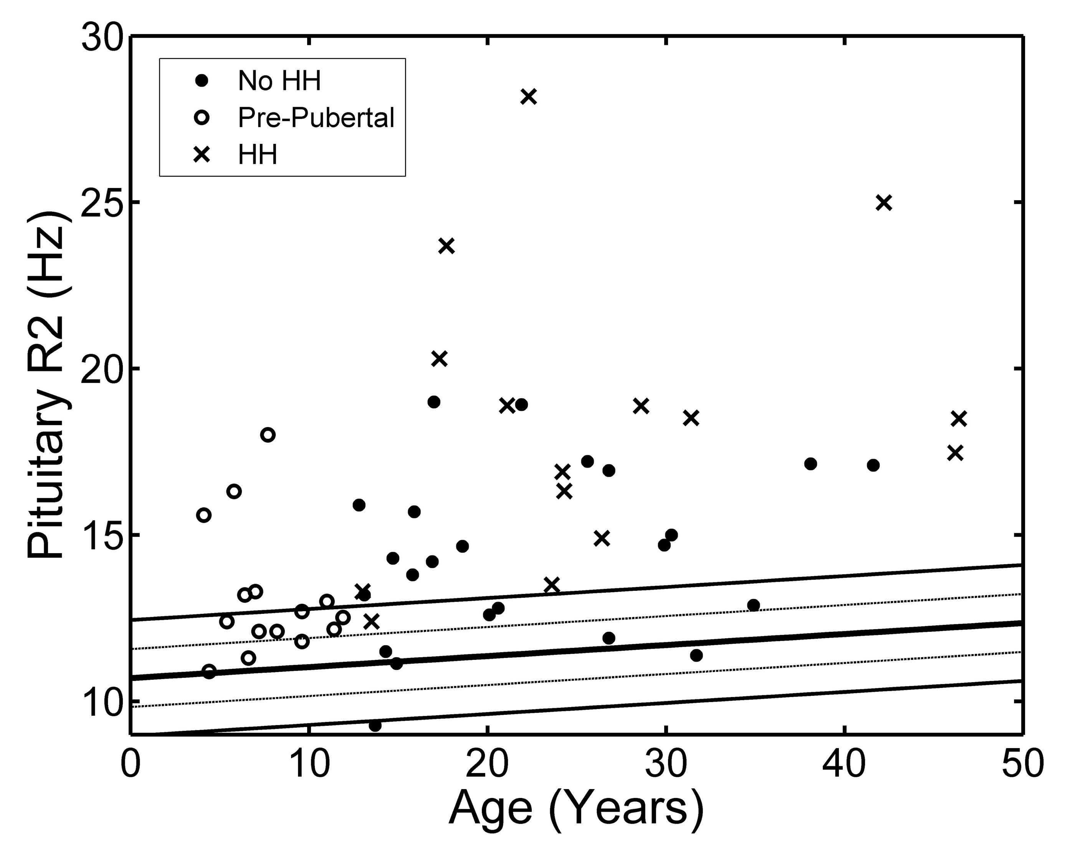
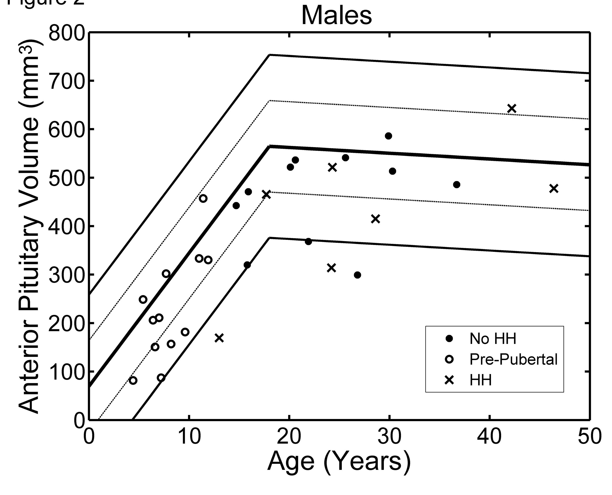
Pituitary volume and iron with age
HH = hypogonadal hypogonadism
Noetzli et al, AJNR,33(2):259:265, 2011
Noetzli et al, Am J Hemato, 87(2), 167-171, 2012

Slide 36
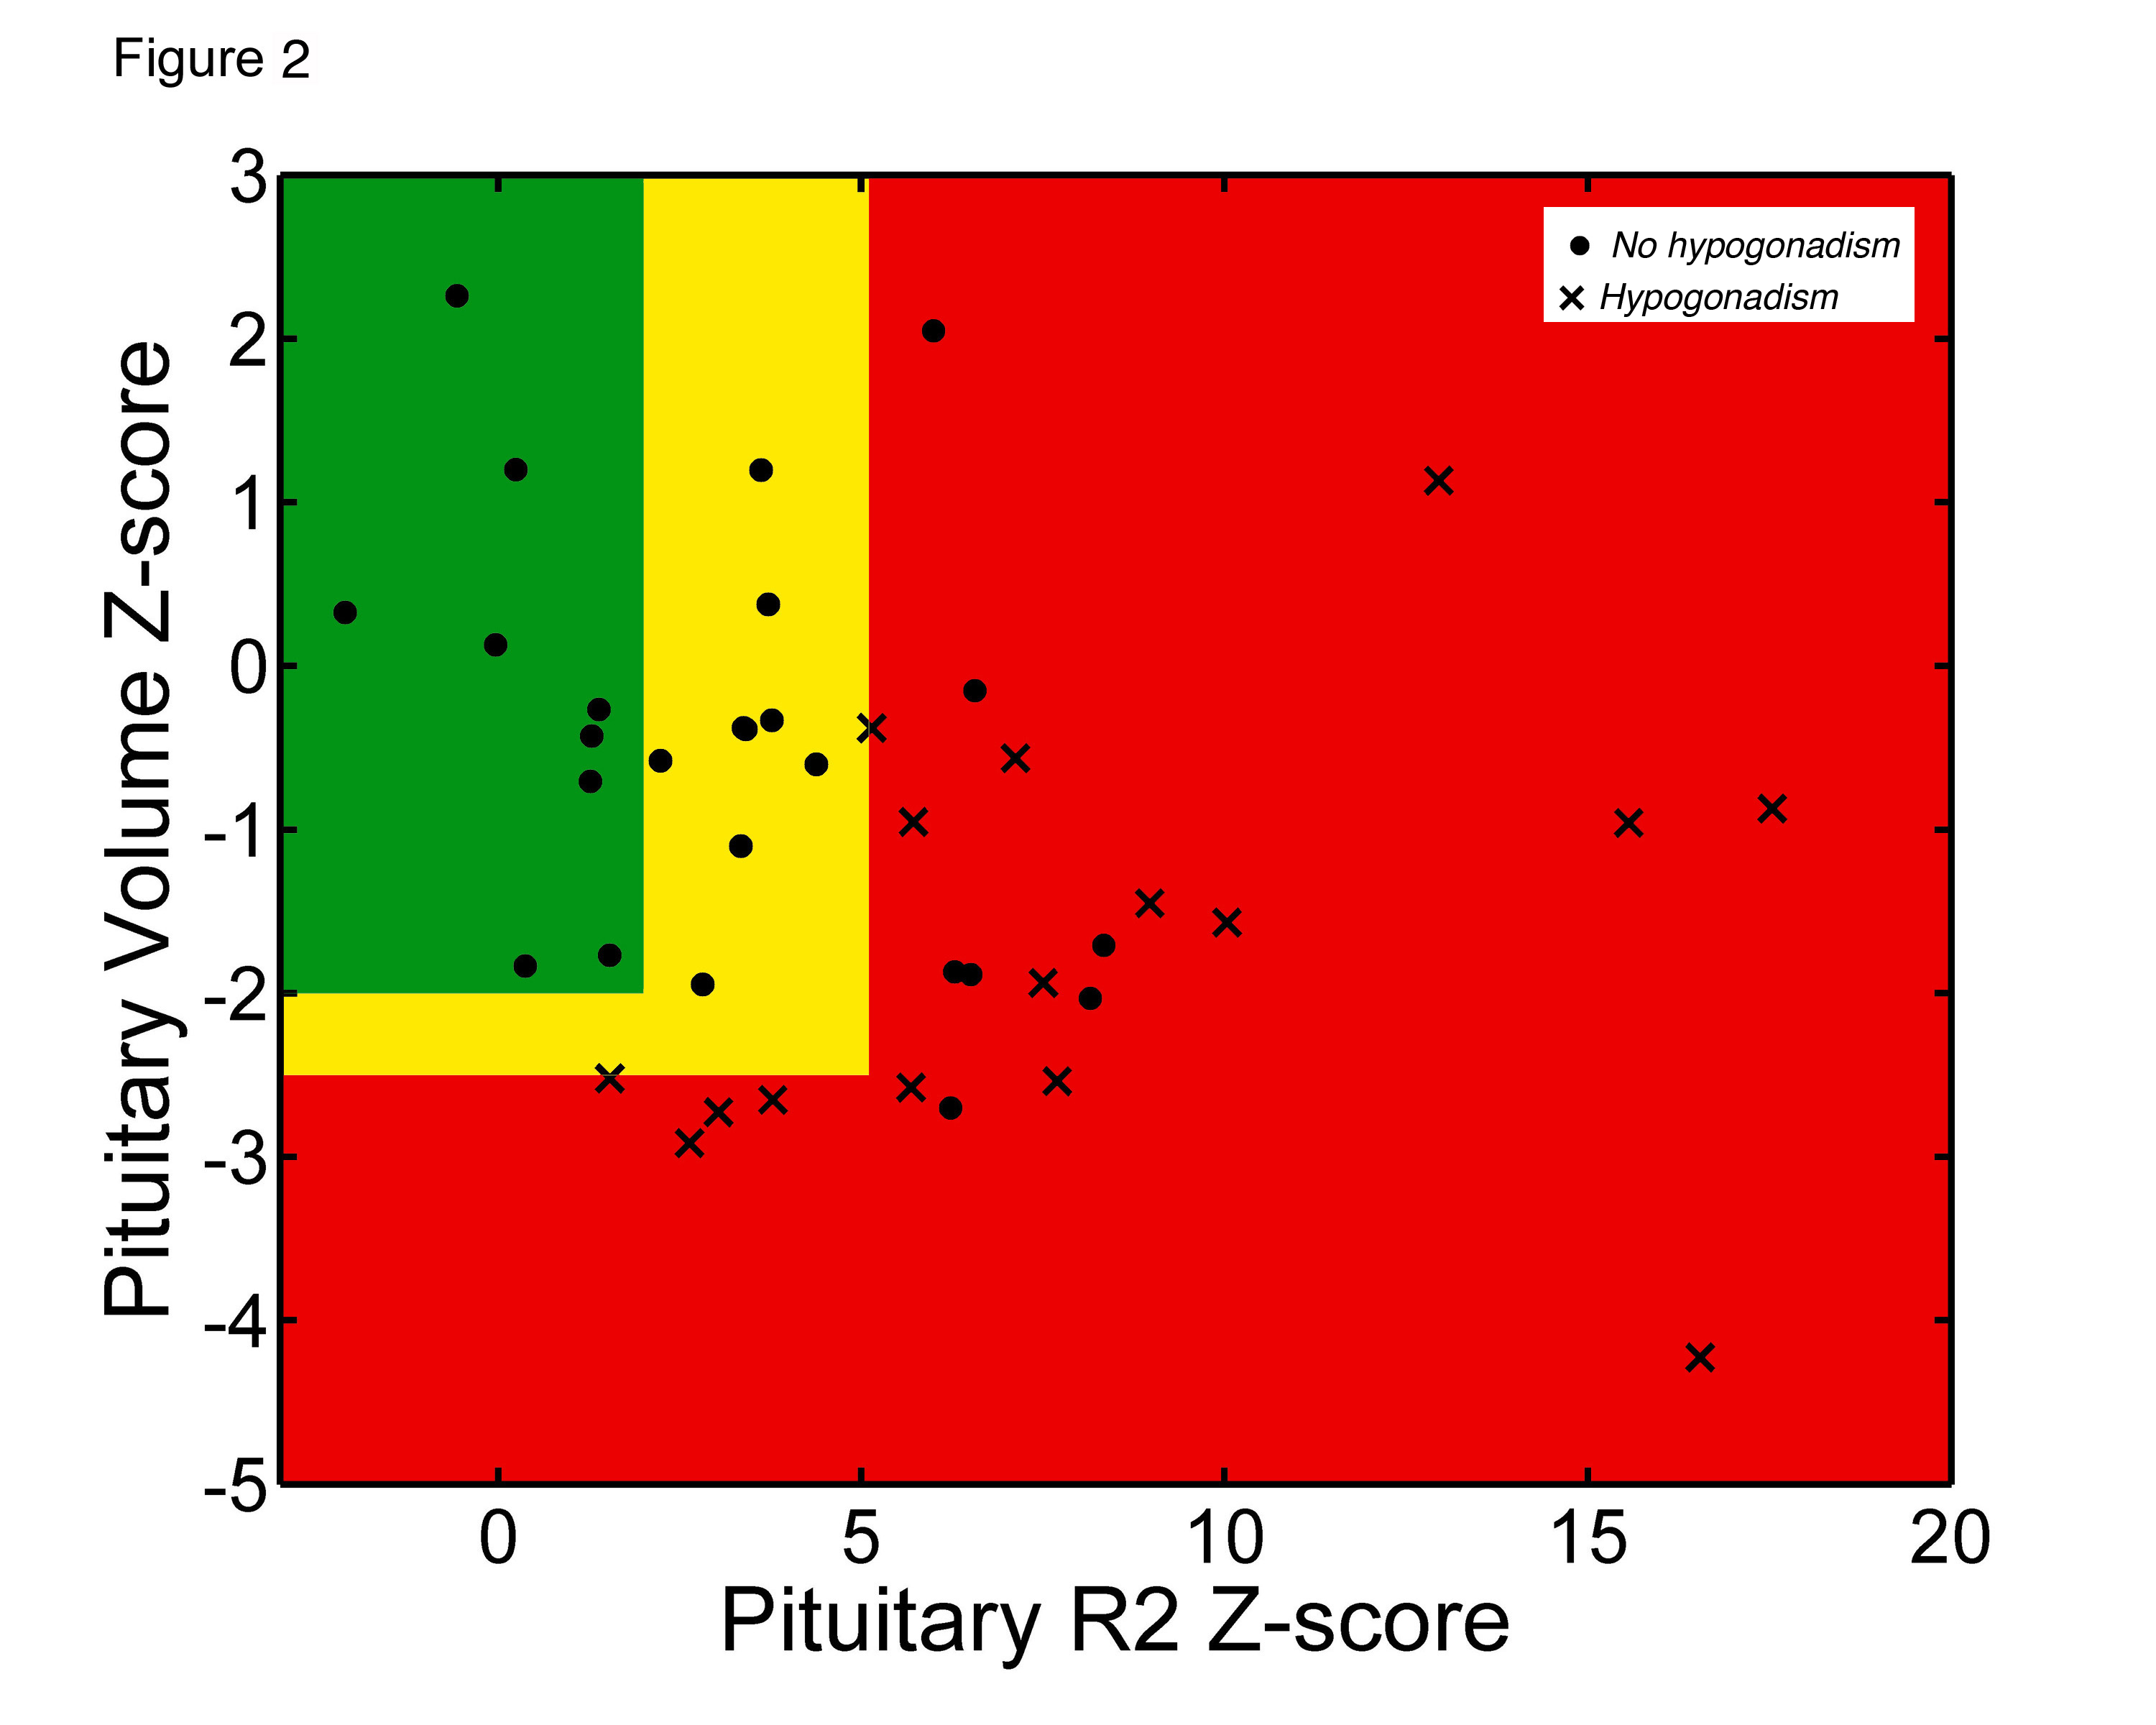
Clinical Correlation: Pituitary R2 and hypogonadism
Heavy Iron Loading
shrinkage
Noetzli et al, Am J Hematol 87(2):167-171, 2012

Slide 37
Practical Monitoring
Testing | Low Risk | Medium Risk | High Risk
Serum Ferritin | With Transfusions | With Transfusions | With Transfusions
Echocardiogram | Annually | Annually | Annually
Endocrine Testing | Case-Specific | Annually | Annually
Abdominal MRI | Annually | Annually | 6 monthly
Heart MRI | Every 3-4 years | Annually | 6 monthly
Pituitary MRI | ??? | ??? | ???
Low Risk: Pancreas R2* < 100 Hz
Medium Risk: Pancreas R2* > 100 Hz, Cardiac T2* > 10 ms
High Risk: Cardiac T2* < 10 ms

Slide 38
When to start scanning
Abdomen scanning, alone, can be performed in < 15 minutes, free breathing. No sedation is needed. Can start in early childhood.
In well transfused, well-chelated children, cardiac iron is rare < 10 years of age
However, Blackfan Diamond and poorly chelated β₀ thalassemia can get cardiac iron before 5 years of age

Slide 39
Summary
MRI accurately measures stored tissue iron in many organs.
Liver takes up both transferrin and NTBI, while endocrine glands and heart only accumulate NTBI.
Organ toxicity reflects both severity and duration of iron loading.
Risk thresholds have been identified for the heart, liver, pancreas and pituitary.
MRI has become the standard of care for monitoring transfusional siderosis.

Slide 40
Why does the radiologist need to know iron physiology ?
Why should I use MRI at all ? I have serum ferritin.
How can my patient have high heart iron when his liver iron is low ? Or vice versa ?
If his heart (or pancreas, or liver) is full of iron, how come he has normal function ?
When should my patient get his first scan? When should he get the next scan ?
Is it ok to just look at the abdomen or do I need to look at the heart, too ?

